Slide 1



Bayesian Full Waveform Inversion
2nd place, Yale/UNC-CH - Geophysical Waveform Inversion
Jeroen Cottaar
Notes:
Recommending picking out he most interesting and important parts from your documentation.

Slide 2
Background
I have a PhD in computational physics
I currently work at ASML, a semiconductor equipment company, in the Netherlands
I’ve been applying Bayesian methods in my career for 5 years, and on Kaggle for 1 year

Slide 3
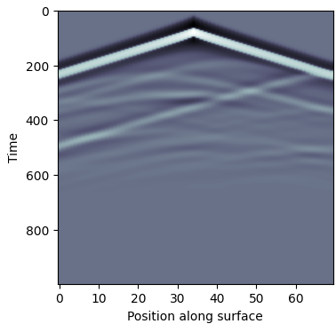
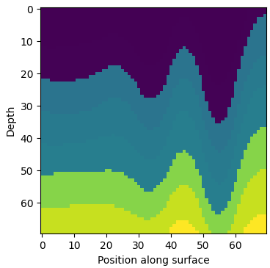
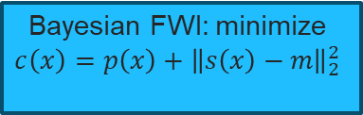
Summary
1
2
3
Deep learning model by Brendan Artley
Select prior: StyleA, StyleB, FlatVel, other
Bayesian FWI: minimize $$c\left(x\right)=p\left(x\right)+{\left\|s\left(x\right)−m\right\|}_{2}^{2}$$
Cost
Prior
Residual
Training
192 hours on 4090
Negligible
Negligible
Inference (per seismogram)
Negligible
Negligible
5 minutes on V100
4
Making it all fast enough
5
Final thoughts: Bayesian methods vs deep learning
Notes:
Mention $700 total cost for inference

Slide 4
Deep learning provides the initial solution
I used the model public shared by Brendan Artley early in the competition; I made no attempts to improve it (assuming deep learning could not go much further…)
Model is CAFormer, a vision transform model with cross-attention
Additional tricks: pixel shuffle (better upsampling), intermediate convolution, spatial and channel squeeze-and-excitation
Everything I know: Brendan's notebook

Slide 5
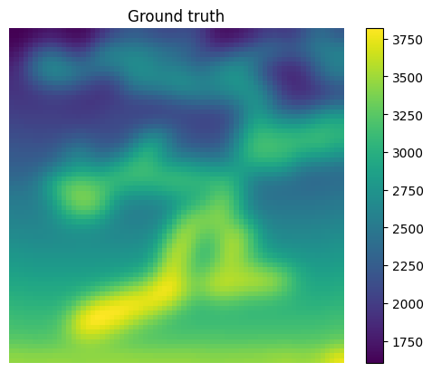
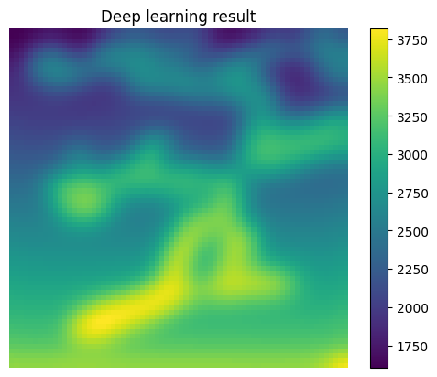

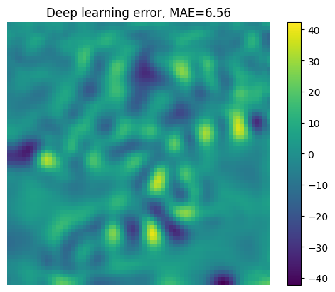
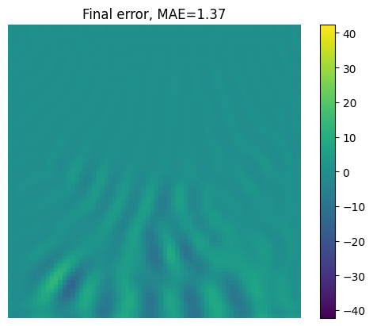
StyleA: Gaussian Process prior
Prior: Gaussian Process with squared-exponential kernel, no noise
Hyperparameters trained using maximum likelihood estimation on training velocity profiles
Public test set score: 3.4

Slide 6
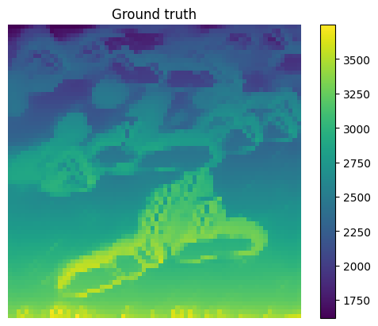
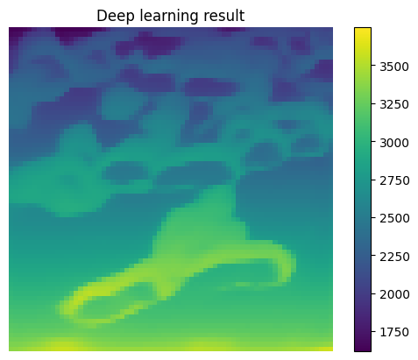

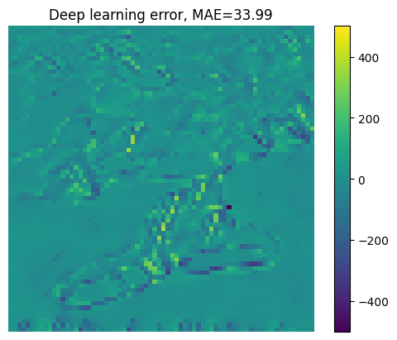
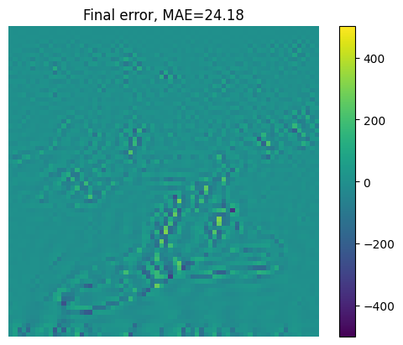
StyleB: Gaussian Process prior (not doing so well…)
Prior: Gaussian Process with squared-exponential kernel, with noise
Hyperparameters trained using maximum likelihood estimation on training velocity profiles
Hard to capture high-frequent stuff
Public test set score: 44.4 ☹

Slide 7
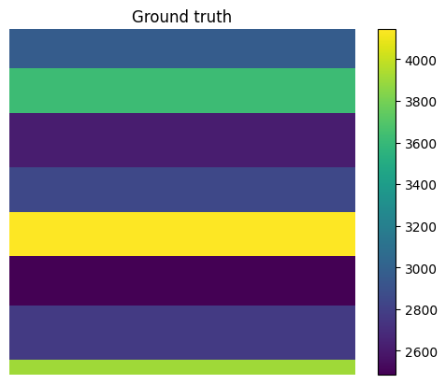


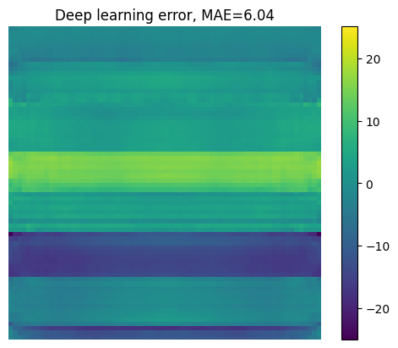
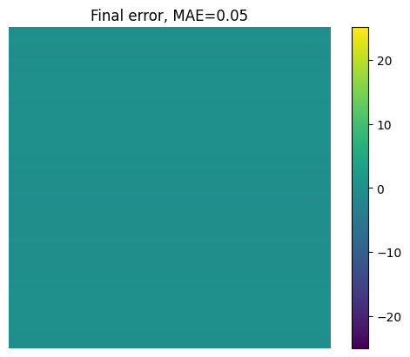
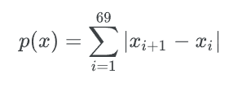
FlatVelA+B: 1D total variation prior
Prior: 1D total variation
Allows sharp jumps, dislikes wiggles
Public test set score: 0.0

Slide 8
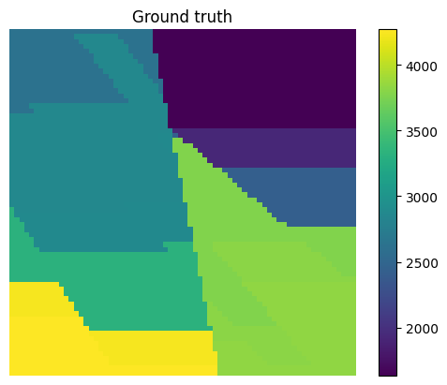

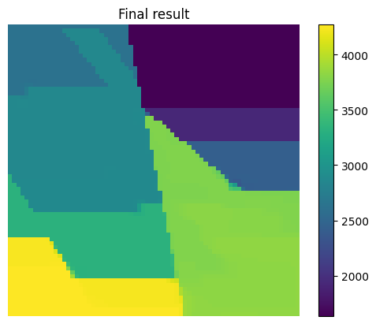
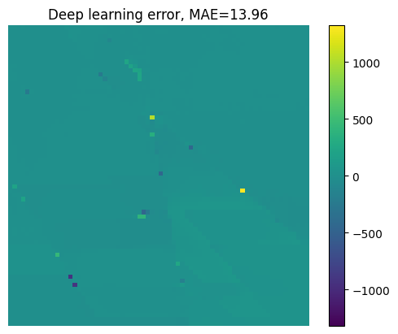
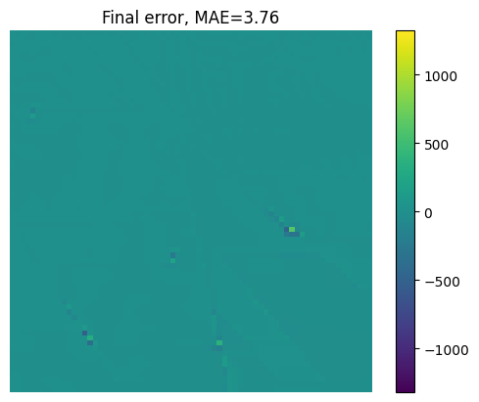
All except FlatVel and Style: 2D total variation prior
Prior: 2D total variation
Hard to capture details near the faults
Public test set score: 4.9

Slide 9
Bayesian Full Waveform Inversion with BFGS and Gauss-Newton
Solver makes use of BFGS and Gauss-Newton in various combinations per family
History size for BFGS was unlimited – even beyond the number of parameters
Gauss-Newton is always with full inversion (not iterative approximation)
The final choice is not really optimal; it evolved this way because I kept refining and reusing previous results
I could find no benefit from preconditioning

Slide 10
Speedup and cost reduction techniques
Custom CUDA kernel for forward modeling: 30 ms to compute seismogram, 70 ms for backward pass to compute gradients (manually implemented, not through Torch)
Custom CUDA kernel to speed up Hessian inversion steps in BFGS
Cost reduction: using V100, an older and cheaper GPU with excellent FP64 performance

Slide 11
Closing thoughts: deep learning vs Bayesian methods for full waveform inversion – within the confines of this competition
 | Bayesian | Deep learning
Training cost | Low | High
Inference cost | High | Low
Prior needed? | Yes – mathematical description | Yes – ability to sample
Uncertainty reported? | Implicitly available | Only for some approaches
Not black or white: can use hybrid approaches
Big unknown: how does this all scale to the real world – especially to 3D and unclear priors

Slide 12
Question and Answer

